Slide 1
Current practices and issues in geotechnical data management in Sweden
Lars Kristian Stölen
2019-01-22

Slide 2

Focus on geotechnical drilling in quatenary material
Notes:
Quaternary cover makes up 98% of Swedens surface
Standardization of geotechnical investigations in crystalline bedrock is a more complex issue

Slide 3
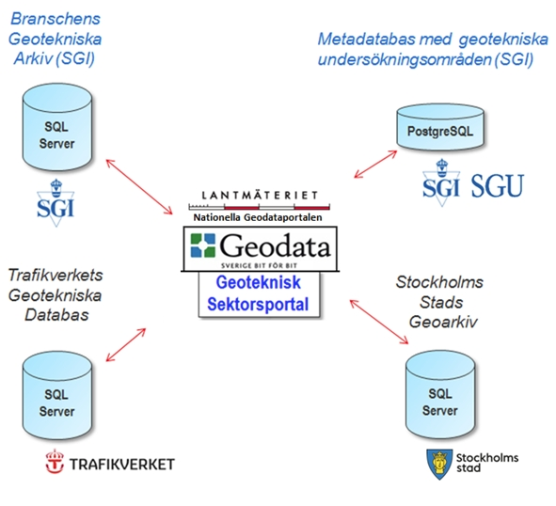
Swedens geotechnical portal. Primary objectives :
To store and distribute data from all ground investigations in Sweden
To present the data through a map-enabled web application
Notes:
Pilot study 2011
2012 – 2013
From field data to WMS services
Field > GeoSuite database > WMS
In reality GeoSuite data export > GeoSuite database > GeoSuite import

Slide 4
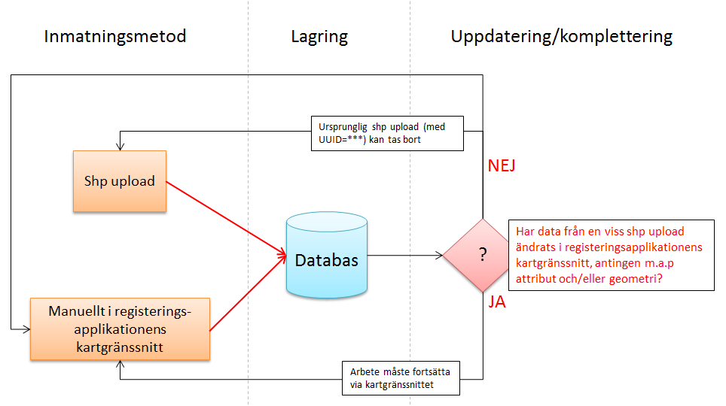
Data delivery
Data owners must organise their own data and deliver these to the geotechical portal.
Delivery through GeoSuite Toolbox or through built in application in the portal
Notes:
Nearly 100% of data delivery is through GeoSuite Toolbox
The built in application is only used for metadata about geotechnical drilling information from drillings that are not in a digital format

Slide 5
Benefits of having and using the geotechnical portal
Re-use of ground investigations (fewer new investigations)
Easier access and reduced time to find data from earlier investigations
Reduced time for project planning, and better plans
Improved emergency preparedness and management for geohazards
Notes:
Important information in the planning phase of infrastructure projects
Regarded as a candidate for national basic data (part of the geology theme)

Slide 6
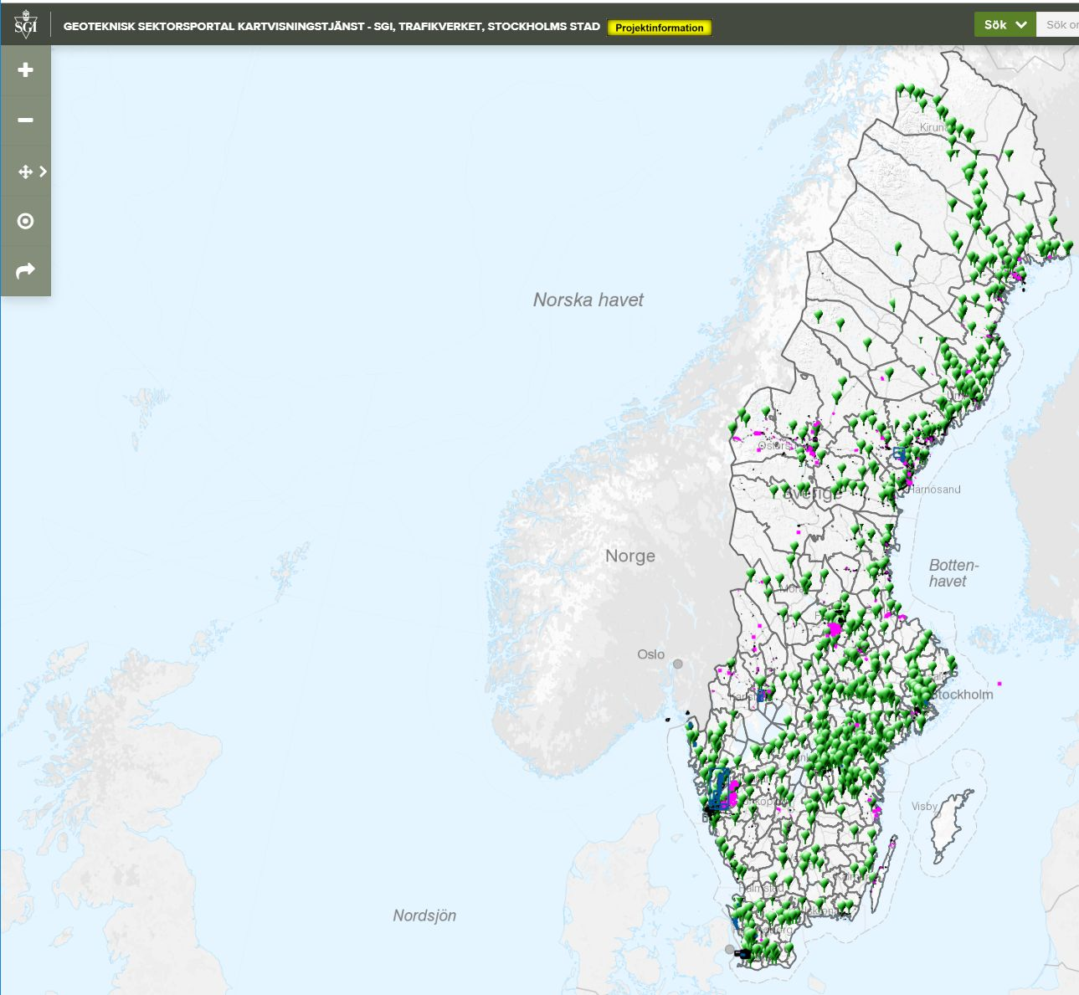
Cooperation of several governmental agencies in Sweden
Geological Survey of Sweden
Swedish Geotechnical Institute
Swedish Transport Administration
Swedish Civil Contingencies Agency
Lantmäteriet (Swedish Land Survey)
Notes:
Building the portal was financed by Swedish Civil Contingencies Agency
Small budget for management and maintenance

Slide 7
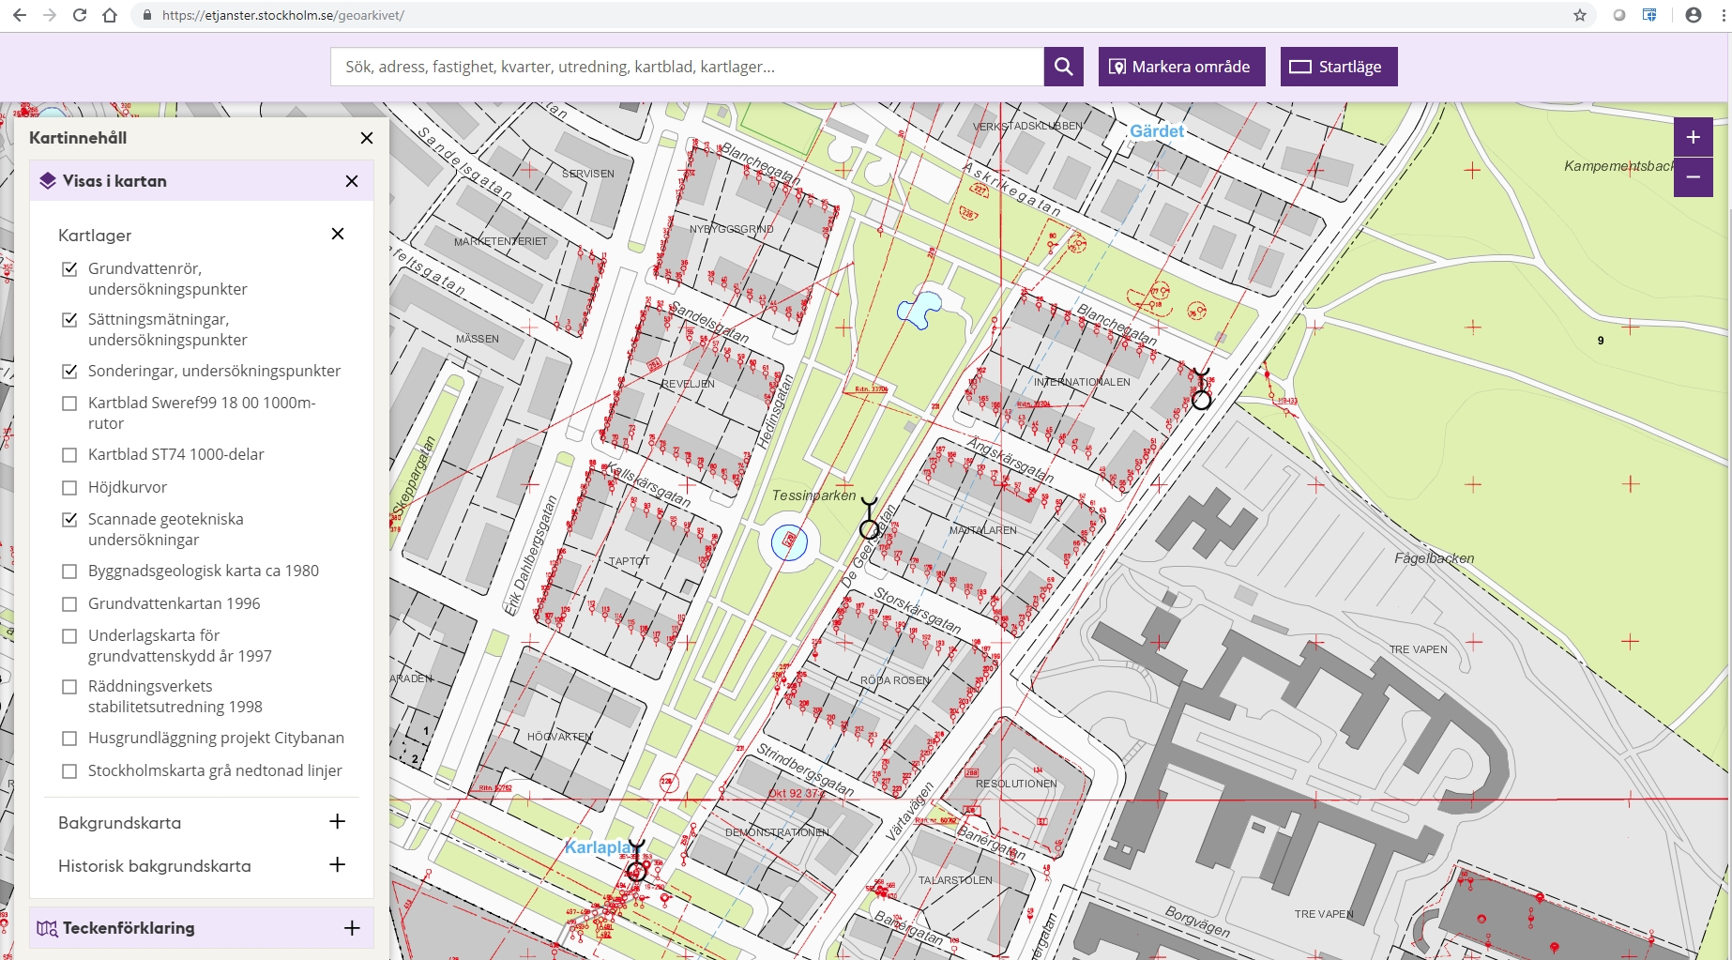
Stockholm city geotechnical archieve
Notes:
Stockholm City har their own portal
Well organized and fully financed management and maintenance

Slide 8
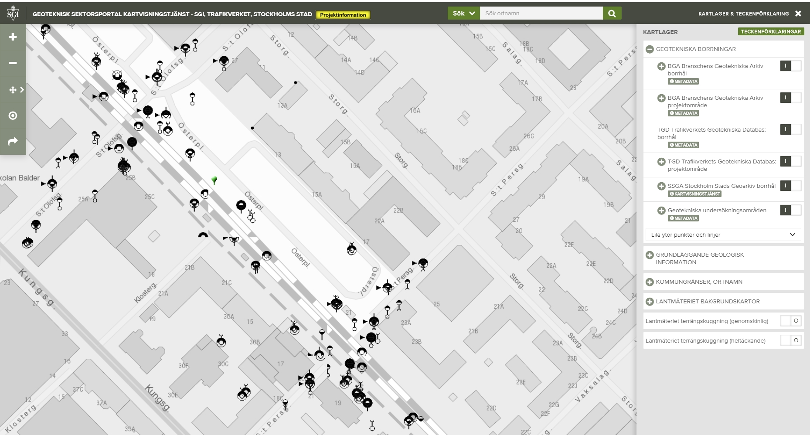
Geotechnical portal
Notes:
Outside Stockholm there is a variation in how much information there is in the portal
Here from Uppsala city, north of Stockholm, only newer information from the Swedish Transport Administration is shown in the national portal
No information from Uppsala City’s own drilling

Slide 9
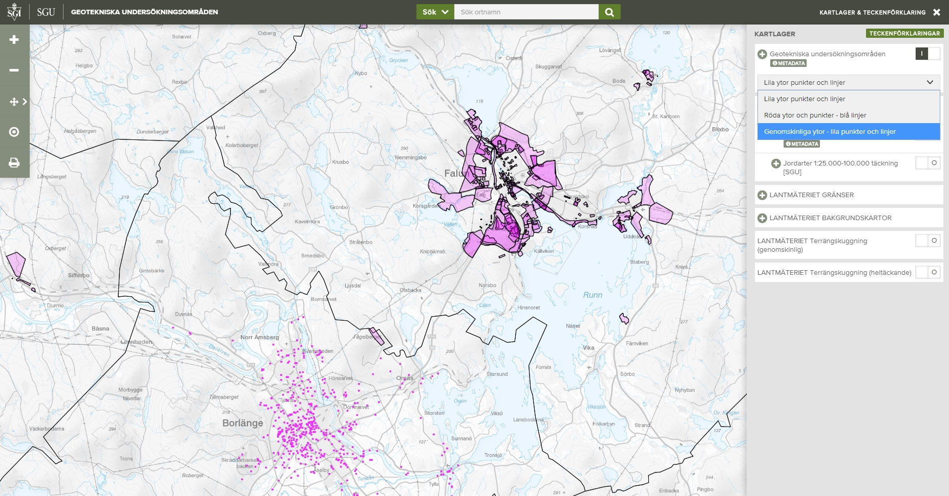
Geotechnical portal
Notes:
Borlänge municipality shows their information in the portal, but the municipality of Falun only shows metadata for mostly non-digital information

Slide 10
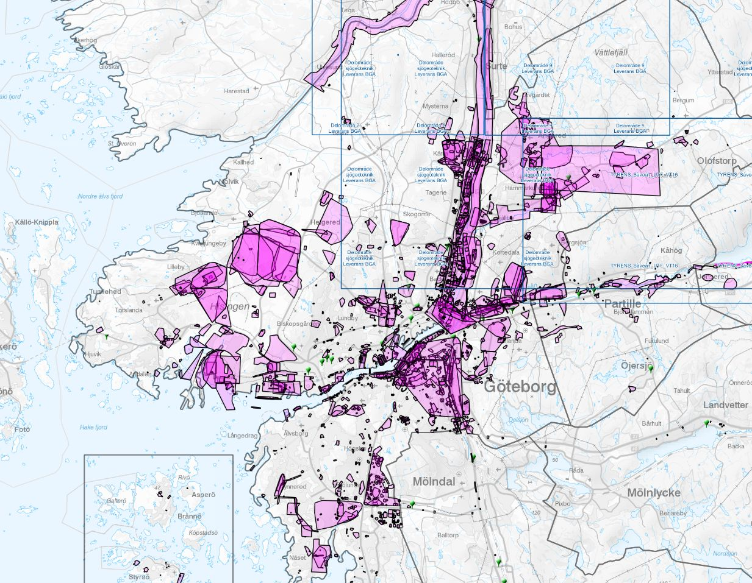
Use of the national portal
A number of major cities and municipalities have their own solution
Stockholm city has 600 000+ geotechnical drillings in their portal
Only 40 000 drill holes in the national portal
Not all information from the Swedish Transport Administration can be found in the portal
Notes:
The standard consulting agreement is part of the reason why the portal contains to little data. According to the agreement the municipality/agency that buys the geotechnical drilling doesn’t own the data !
As a result the consult keeps the data and often resell it
Stockhom city has a solution for this

Slide 11
New national portal
As part of the Swedish Government ”Digital First” initiative a new portal is planned since geotechnical information is regarded as important basic data in the infrastructure building process.
It is more about organization and law than about technology
Data as open data, open standards and open formats
Part of a new national (machine to machine) platform for geodata access
How do we convince those who have their own portals to use a national solution?
Is there a need for a key register?

Slide 12



Digital workflow
Geotechnical investigations
Groundwater and energy wells
Notes:
Establishing an information flow (API) of both geotechnical information and geological information to BIM models and city information models is a challenge
Is BIM and City information model compatible?
Even bigger challenge if we want life cycle management of the information
Do we need to visualize everything? It’s important that there is links to relevant “extra” information in the BIM model

